Slide 1

Image Processing and Computer Vision TMC 303
Dr. Nisha Chandran S.
Associate Professor
School of Computing

Slide 2

Unit 1
Lecture 2

Slide 3
Fundamental Steps in digital image processing:

Slide 4
Image Acquisition:
image given in the digital form, includes pre-processing steps like scaling.
Image Enhancement:
manipulate the image so that the result is more suitable for a specific application
more subjective, more appealing to human
Techniques for X-ray images and satellite images are different
Image Restoration:
improve the appearance of the image
more objective
Based on the analysis of the image
mathematical techniques used for restoration
Color Image Processing:
concepts of color models
color image processing
Basis for extracting features of interest from an image

Slide 5


Slide 6
Wavelets processing:
Used for representing images in varying degrees of resolution
Used for image data compression
Compression:
reducing the storage required to save an image
or the bandwidth required to transfer it
JPEG(Joint Photographic Experts Group) image compression standard
Morphological Operation:
Tools for extract image components that are useful for representation and description of shape.
Segmentation:
Partition an image into constituent parts or objects
Most difficult task in all the steps
more accurate the segmentation, more accurate is the object classification and recognition

Slide 7
Feature Extraction:
Image data represented in the form of boundary, or as a complete region
Boundary : focus if on external characteristics such as corners or inflections
Complete region: focus if on features like texture
Includes feature detection (finding the feature of an image)
Includes feature description( assigns quantitative measure to the detected features)
E.g detect corners and describe that in the form of their orientation and location
All processes not required always, as the complexity of the image processing task increases, no. of process required increases.

Slide 8
Image pattern Classification:
Assign a label to an object (say ‘vehicle’)
Labelling done based on the feature descriptors
All processes not required always, as the complexity of the image processing task increases, no. of process required increases.
Image enhancement for human interpretation does not require any of the other stages
Knowledge base:
Knowledge about a problem domain
Can be simple (detailing regions in an image)
Or complex
all possible defects in a materials inspection problem
Set of high-resolution satellite images of a region in connection with a change detection applications

Slide 9
Components of a digital image
processing system

Slide 10
Image sensors:
To acquire a digital image two things are required
Physical sensor: responds to the energy radiated from the object we image (CCD chips)
Digitizer: output of the physical sensing device into a digital form
Specialized hardware:
Digitizer
ALU units for parallel operations in the entire image (front end subsystems)
One or more GPUs for intense matrix operations etc.
Computer:
Anything from a PC to a supercomputer
Software:
E.g. Commercially available software like MATLAB Image processing Toolbox
Mass Storage:
Image of size 1024x1024 requires almost 1Megabyte (10^6) of storage
Millions of similar images required for some applications

Slide 11
Image displays:
Flat screen monitors mainly color
Run by graphic display cards
Stereo displays implemented as a head gear
Displays will be in goggles worn by the user
Hardcopy devices:
For recording images (laser printers, optical disks, CD ROMS etc)
Networking and Cloud:
For communication
Band width is a challenge while transmitting images
Optical fibre and other broadband technologies are available now
Image compression plays a major role in transmission

Slide 12
Why digitize?
Output of most of the sensors are analog signals
Theory of Real numbers: between any two given points
Each image point may contain infinitely many possible
Intensity or color values.
These points require infinite no. of bits to be stored in a computer (not possible)
So, we need to digitize the signal to store it in a computer

Slide 13
Digitization process involves:
Sampling
Quantization
After digitization the image is represented as a 2D array of M rows and N columns where each point is a discrete value
Analog Signal
Sampling
Quantization
Digital Computer
Digital Computer
Digital to Analog converter
Display

Slide 14
Digitizing the coordinate values is called sampling
Digitizing the amplitude is called quantization
Sampling: decided by the sensory arrangement (no. of sensors in the sensing strips)

Slide 15
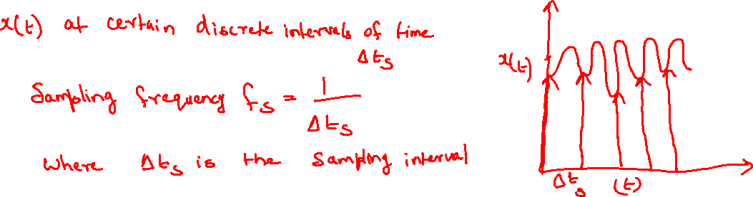

Sampling
Consider a 1D signal x(t)
X(t) and t can take any values
Analog signal
Cannot be represented as such on a computer
We have to sample it
Consider value of x(t) at certain discrete elements of time

Slide 16
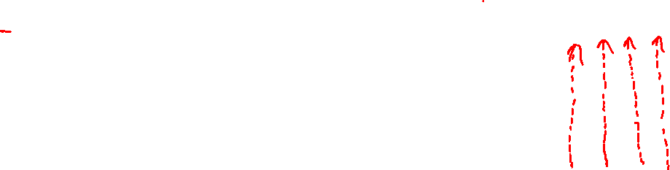

Information loss
Increase the sampling frequency or reduce the sampling interval
Take more no. of points

Slide 17
New sampling frequency is now increased to twice the previous values
f_{s}’ = 2f_{s}
Results in capturing more points, so more information
Digitization is mathematically represented as
X_{s}(t)= X(t).comb(t, delta t)
At an interval of delta t this function gives the value 1 and 0 at all points
X_{s}(t)= X(t).1 (at points at a distance of delta t)
X_{s}(t)= X(t).0 (at all other points)
Sampling is proper only if we can reconstruct the original signal from the sampled signal
Quality of the reconstructed signal increases when we increase the sampling frequency

Slide 18
Sampling along x axis
After sampling we have a set of values which are still analog
So, we have to quantize(partition)
Quantization along y axis
Intensity scale is divided into 8 discrete values ranging from 0 to 1
One of the 8 values is assigned to each of the sample depending on to which value on scale the point is closest to

Slide 19
Quantization
Mapping of a continuous variable U to a discrete variable U’
U’ belongs to some reconstruction level r
U’ belongs to {r₁,r₂,r₃….r_{L}} , a set of discrete values
Sampled value must be converted to a discrete value
Mapping is done using the staircase function
Quantization Rule
Define a set of decision or transition levels t_{k} where {k= 1,2, 3..L+1}
t₁ is the minimum level and t_{L+1} is the maximum level
U’ = r_{k} if t_{k}<u<t_{L+1}
r_{k} is the reconstruction level
If the input level value u is between t_{k}<u<t_{L+1} U’ will take the value r_{k}

Slide 20
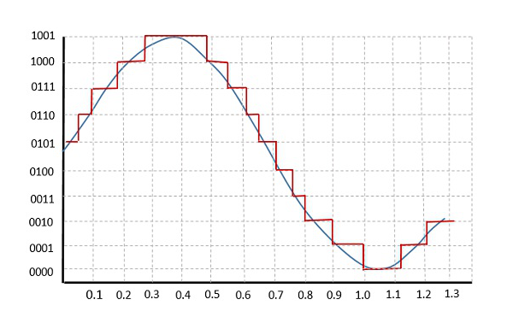
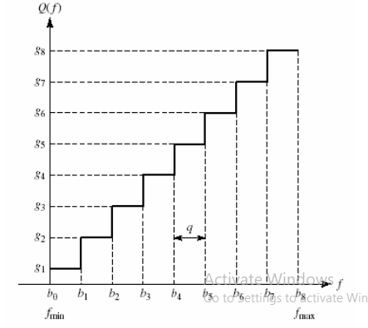
Staircase function
Input signal between b0 and b1 the quantized value is g1
Input signal between b1 and b2 the quantized value is g2
Etc….

Slide 21
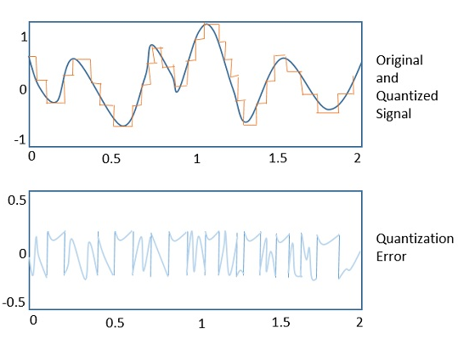
Quantization error
The difference between an input value and its quantized value

Slide 22
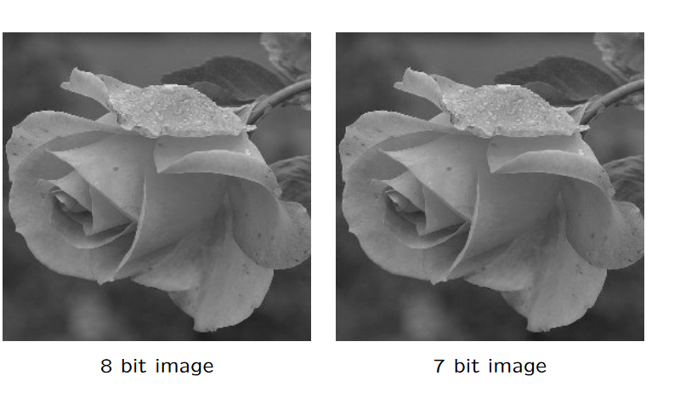
Example images

Slide 23
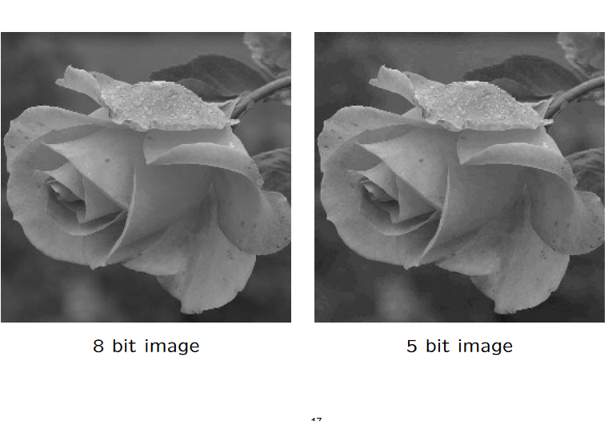
Example images

Slide 24
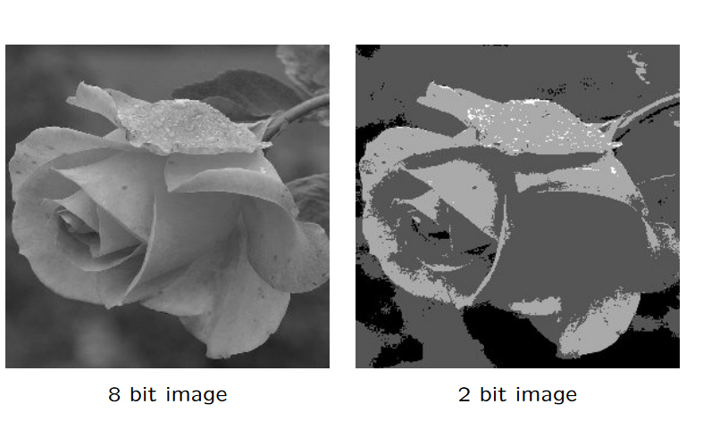
Example images

Slide 25
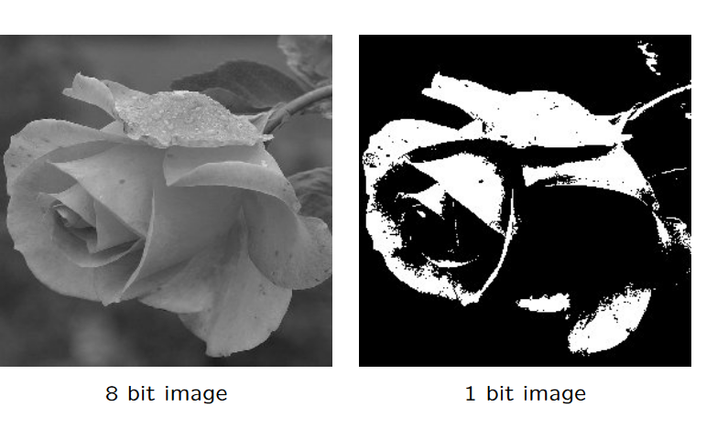
Example images

Slide 26
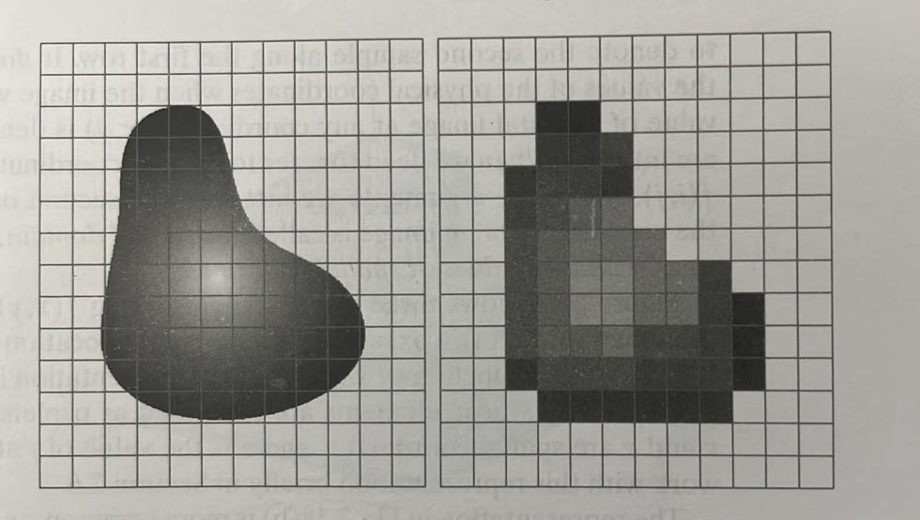
Result of image sampling and Quantization

Slide 27
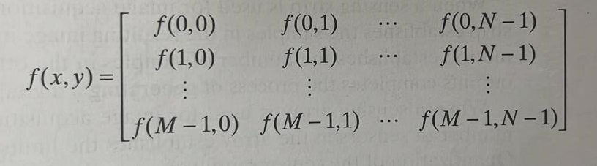
Representation of images

Slide 28
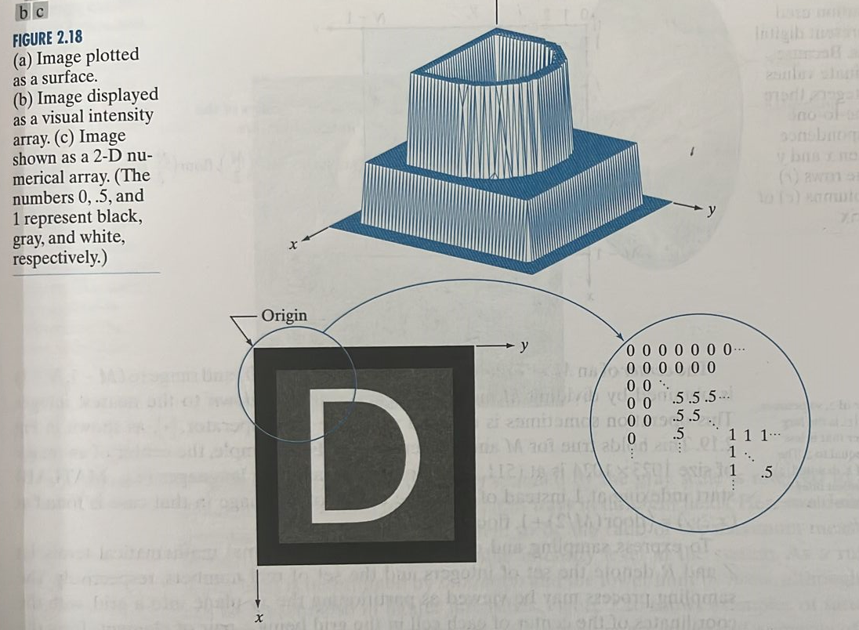

Slide 29
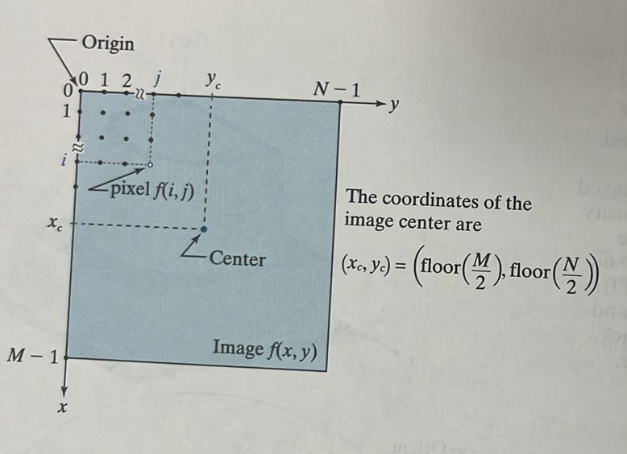
Coordinate convention used to represent digital images
Center of an image of size 1024x1024 is?
(512,512)

Slide 30
Spatial and Intensity Resolution
Spatial Resolution: Smallest detail in an image
Pixels per unit distance or dots per inch(dpi)
dpi normally used in printing and publishing industry
e.g. Newspapers : 75dpi
Magazines : 133dpi
Glossy brochures: 175dpi
Textbooks with glossy finish : 2400dpi
Image resolution of 1024x1024 pixels is not meaningful
It is just the image size

Slide 31
Intensity Resolution : smallest change in intensity
Usually measured in integer powers of 2
Commonly 8 bits is used
Image whose intensity is quantized into 256 levels has 8 bits of intensity resolution

Slide 32
Types of Images
Binary image:
Each number associated with the pixel can
have only two values; either 1 or 0.
1 is for while and 0 is for black
Example: image of size 384 X 512
1 1 1 1 1 1 1 1 1 1 0 0
1 1 1 1 1 1 1 1 1 1 0 0
1 1 1 1 1 1 1 1 1 1 0 0
1 1 1 1 1 1 1 1 1 1 0 0
1 1 1 1 1 1 1 1 1 1 0 0
1 1 1 1 1 1 1 1 1 1 1 0
1 1 1 1 1 1 1 1 1 1 1 0
1 1 1 1 1 1 1 1 1 1 1 0

Slide 33
Grayscale Image:
All values between 0 and 255
0 represents black
255 represents white
384 X 512
67 72 77 78 79 78 76 75 75 74 72 71 69 67 61 38 29
56 54 53 53 52 50 47 46 45 44 40 41 41 41 67 67 71
56 56 54 53 53 52 52 51 49 46 44 44 43 40 41 42 40
54 53 53 52 50 50 50 49 48 45 43 43 41 38 40 41 41
53 53 52 51 50 50 49 49 49 45 43 43 40 40 41 42 40
50 51 50 49 49 50 49 47 45 44 41 41 40 40 41 43 42

Slide 34
Color Image:
RGB image
Each pixel has 3 values representing the red, green and blue colors
Can be represented as a percentage of red green
and blue components combined
Take a weighted sum of the RGB values to get
the color image
384 X 512 X3
20% of Red
30% of Green
50% of Blue

Slide 36
Image with low and medium amount of detail

Slide 37
Image with large amount of detail

